Slide 1


Foundations: Part 2
John Beverley
Assistant Professor, University at Buffalo
Co-Director, National Center for Ontological Research
Affiliate Faculty, Institute of Artificial Intelligence and Data Science

Slide 2
Outline
National Intelligence Estimate
Knowledge, Defeaters, and Stakes
Deductive, Inductive, and Abductive Arguments

Slide 3
Outline
National Intelligence Estimate
Knowledge, Defeaters, and Stakes
Deductive, Inductive, and Abductive Arguments

Slide 4
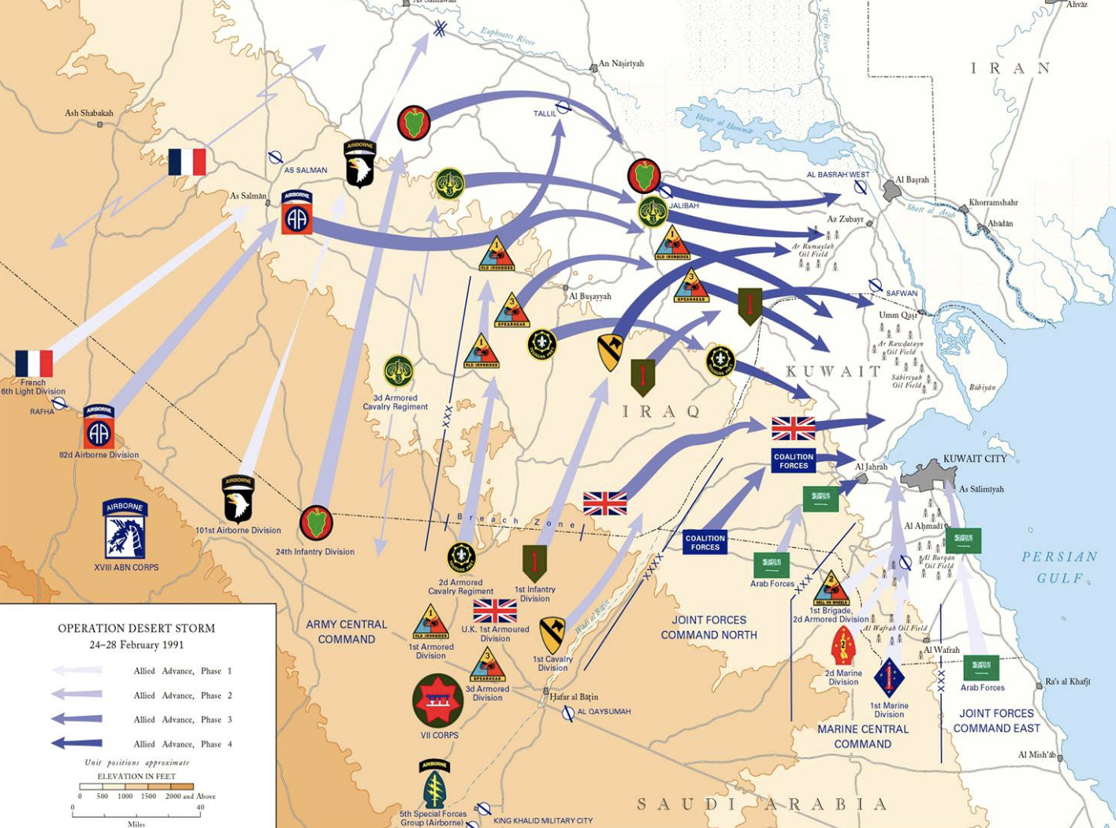
1991 Gulf War
In 1990, Iraq invaded Kuwait and leveraged weapons of mass destruction during the invasion, e.g. chemical weapons
In 1991, a coalition of nations led by the U.S. liberated Kuwait
Sanctions were imposed on Iraq; in particular, the government was required to cease research and development of weapons of mass destruction

Slide 5
2003 Invasion of Iraq
Preceding 9/11, there had been concerns over the extent to which Iraq was or was not conducting R&D on weapons of mass destruction
Following 9/11, the U.S. declared war on Iraq on the pretext that the government was conducting such research and had been involved in the attacks
Justification was based on a U.S. National Intelligence Estimate

Slide 6
National Intelligence Estimate (NIE)
Considered to be among the most authoritative intelligence analysis documents that can be produced
Involves expert intelligence analysis input from all U.S. government intelligence agencies; is indeed signed by the directors of each agency
An NIE was producted on the topic of Iraq’s potential R&D regarding weapons of mass destruction

Slide 7
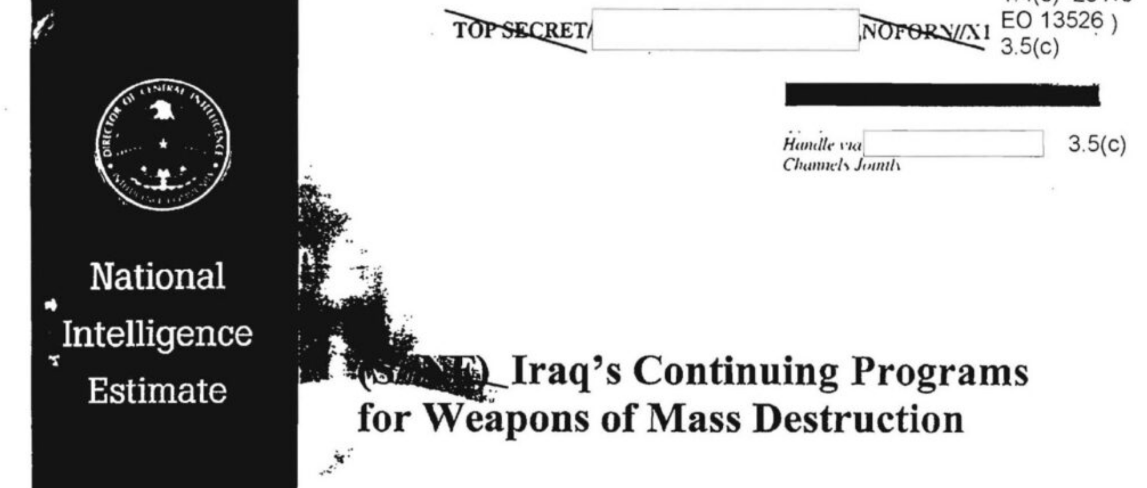
National Intelligence Estimate (NIE)
Despite stating intelligence agencies had limited information about the potential counter-intelligence in Iraq at the time, tentative conclusions were drawn that Iraq continued its weapons of mass destruction programs

Slide 8
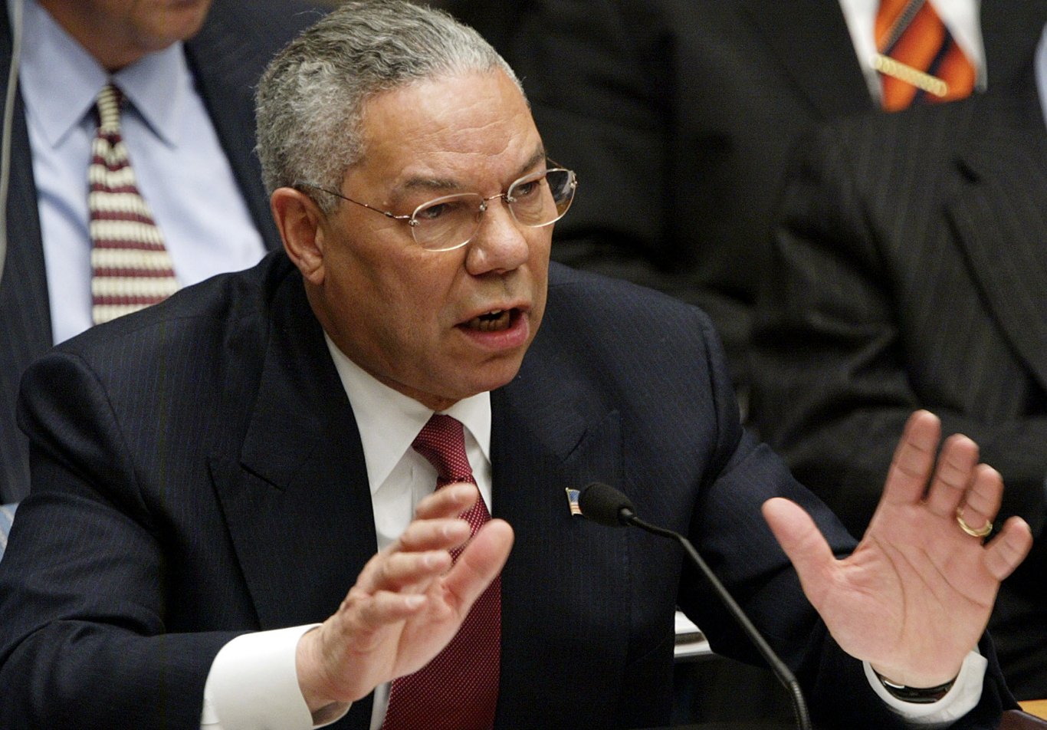
2003 Invasion of Iraq
Secretary of State Colin Powell presented the U.S. case to the United Nations in the interest of garnering support
"My colleagues, every statement I make today is backed up by sources...What we're giving you are facts and conclusions based on solid intelligence...Saddam
Hussein has chemical weapons...and Saddam Hussein has no compunction about using them again — against his neighbors, and against his own people."

Slide 9
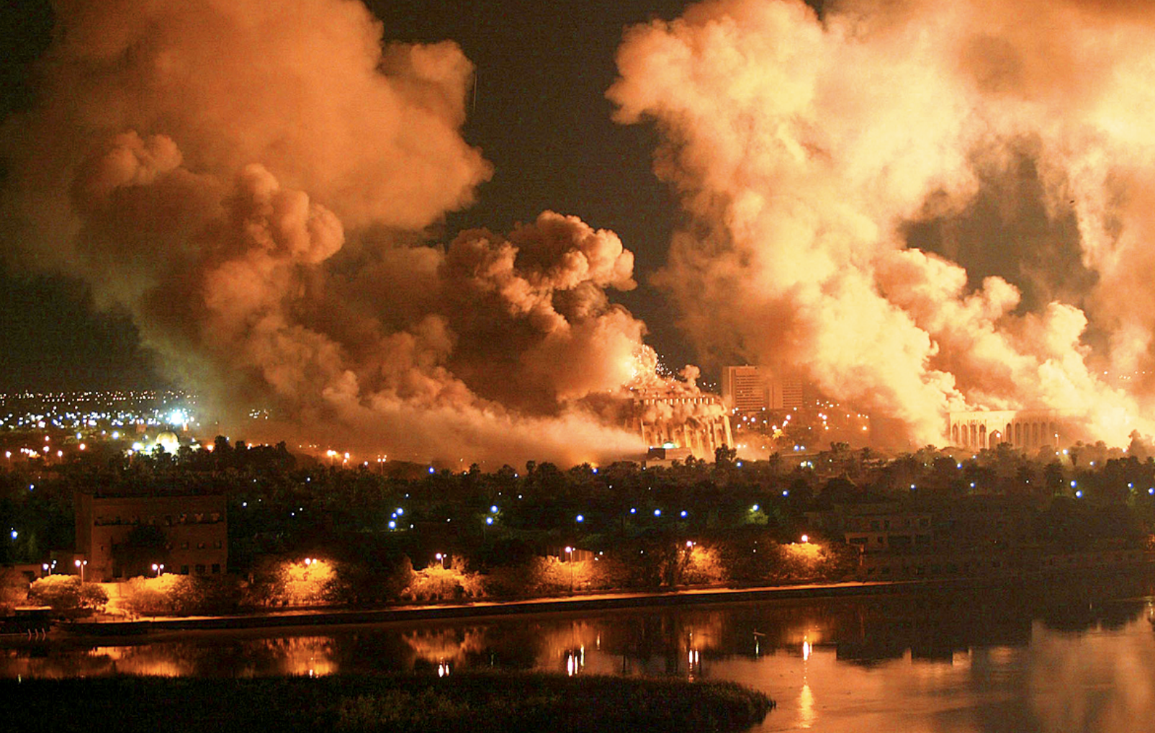
Intelligence Failure
The U.S. and coalition forces toppled the Iraq regime led by Saddam Hussein within a week; no weapons of mass destruction were found
In 1991, Hussein lied about weapon manufacturing, but following sanctions he closed down such operations
However, he did not tell the Iraqi people or his cabinet because he did not want to appear weak; he assumed U.S. intelligence was so good it would know

Slide 10
Intelligence Failure
They did not
Intelligence analysts in the U.S. believed that because Hussein had lied about weapons of mass destruction before the Gulf War, he was likely lying again
They were right that he was lying, but wrong about what he was lying about

Slide 11
Explanation
The content of the NIE justifying war supported multiple conclusions, some of which suggested Hussein was engaged in relevant R&D, some of which suggested otherwise
The Bush administration took a strong stand on the former conclusion, despite conflicting intelligence
Putting political motivations aside, the job of the intelligence analysts in this case were – as they often are – challenging

Slide 12
Explanation
The content of the NIE justifying war supported multiple conclusions, some of which suggested Hussein was engaged in relevant R&D, some of which suggested otherwise
The Bush administration took a strong stand on the former conclusion, despite conflicting intelligence
Putting political motivations aside, the job of the intelligence analysts in this case were – as they often are – challenging
IT IS WORTH EXPLORING WHY

Slide 13
Outline
National Intelligence Estimate
Knowledge, Defeaters, and Stakes
Deductive, Inductive, and Abductive Arguments

Slide 14
Knowledge
“Knowledge” is spoken of in many ways
One might be said to know that something is true; this is propositional knowledge
John knows that the Sun is a star.
One might be said to know how to do something; this is knowledge how
John knows how to drive an automobile

Slide 15
For JTB
Knowledge seems to involve:
Belief – If S knows P, then S believes P is true
Truth – If S knows P, then P is true
Justification – If S knows P, then S has justification for believing that P is true
But knowledge cannot be defined solely in terms of justified true belief

Slide 16
Knowledge is More than JTB
Suppose Sam sees the time on a grandfather clock in a hall in the morning reads ‘8:20’. On this basis, Sam believes it is 8:20 a.m. Suppose it is 8:20 a.m. Now, Sam usually comes downstairs in the morning about this time and this clock has been very reliable for many years. Sam has no reason to think that it is faulty. Sam is thus justified in believing the clock is correct. Suppose, however, the clock stopped 24 hours earlier, so that Sam is now forming his justified true belief by looking at a stopped clock.
Intuitively, Sam lacks knowledge in this case even though it is 8:20 am, he is justified in believing it is 8:20 am, and he believes it is 8:20 am. Ultimately, Sam’s accuracy in this case is a matter of luck.

Slide 17
Upshot
This is just to say that when evaluating whether someone has knowledge, it is not enough to show they have justified true beliefs
One must also be able to rule out matters of luck, of the sort just described
Which itself is neither an easy thing to formalize nor an easy thing to determine outside of the classroom

Slide 18
For our Purposes
Of course, knowledge in such a robust sense might be too far a goal for the purposes of intelligence analysis
Analysts must more often inhabit a world of uncertainty
Even so, the components of knowledge – justification, belief, and truth – are relevant to intelligence analyst tasks
Of particular importance then is how beliefs may be defeated

Slide 19
Epistemic Defeaters
A defeater for a belief or knowledge is evidence that the belief or knowledge is false

Slide 20
Epistemic Defeaters
A defeater for a belief or knowledge is evidence that the belief or knowledge is false
A rebutting defeater for proposition P is evidence that ~P is true, e.g. the belief that it is not snowing in Buffalo is rebutted by walking outside

Slide 21
Epistemic Defeaters
A defeater for a belief or knowledge is evidence that the belief or knowledge is false
A rebutting defeater for proposition P is evidence that ~P is true, e.g. the belief that it is not snowing in Buffalo is rebutted by walking outside
An undercutting defeater for P is evidence against P but not evidence for ~P, e.g. the belief that it is not snowing would be undercut by recognition that one had ingested psychodelics

Slide 22
Even More Complications...
It seems plausible that your environment may affect whether you know or are in a position to know or have justified belief in some content
Pragmatic Encroachment is a thesis in epistemology that maintains differences in pragmatic environment may constitute differences in knowledge

Slide 23
Low Stakes
Hannah and her wife Sarah are driving home on a Friday afternoon. They plan to stop at the bank on the way home to deposit their paychecks. It is not important that they do so, as they have no impending bills. But as they drive past the bank, they notice that the lines inside are very long, as they often are on Friday afternoons. Realizing that it wasn’t very important that their paychecks are deposited right away, Hannah says, “I know the bank will be open tomorrow, since I was there just two weeks ago on Saturday morning. So we can deposit our paychecks tomorrow morning”.

Slide 24
Low Stakes
Hannah and her wife Sarah are driving home on a Friday afternoon. They plan to stop at the bank on the way home to deposit their paychecks. It is not important that they do so, as they have no impending bills. But as they drive past the bank, they notice that the lines inside are very long, as they often are on Friday afternoons. Realizing that it wasn’t very important that their paychecks are deposited right away, Hannah says, “I know the bank will be open tomorrow, since I was there just two weeks ago on Saturday morning. So we can deposit our paychecks tomorrow morning”.
Hannah seems to know the bank will be open

Slide 25
High Stakes
Hannah and her wife Sarah are driving home on a Friday afternoon. They plan to stop at the bank on the way home to deposit their paychecks. Since they have an impending bill coming due, and very little in their account, it is very important that they deposit their paychecks by Saturday. Hannah notes that she was at the bank two weeks before on a Saturday morning, and it was open. But, as Sarah points out, banks do change their hours. Hannah says, “I guess you’re right. I don’t know that the bank will be open tomorrow”.

Slide 26
High Stakes
Hannah and her wife Sarah are driving home on a Friday afternoon. They plan to stop at the bank on the way home to deposit their paychecks. Since they have an impending bill coming due, and very little in their account, it is very important that they deposit their paychecks by Saturday. Hannah notes that she was at the bank two weeks before on a Saturday morning, and it was open. But, as Sarah points out, banks do change their hours. Hannah says, “I guess you’re right. I don’t know that the bank will be open tomorrow”.
Hannah does not see to know the bank will be open

Slide 27
Outline
National Intelligence Estimate
Knowledge, Defeaters, and Stakes
Deductive, Inductive, and Abductive Arguments

Slide 28
Evidence & Valid Arguments
Among the goals of intelligence analysis is to provide justification for conclusions drawn from investigations
Justification is often tied up in argumentation; broadly speaking we can distinguish three major types of argument
Deductive Arguments
Inductive Arguments
Abductive Arguments

Slide 29
Evidence & Valid Arguments
Among the goals of intelligence analysis is to provide justification for conclusions drawn from investigations
Justification is often tied up in argumentation; broadly speaking we can distinguish three major types of argument
Deductive Arguments
Inductive Arguments
Abductive Arguments

Slide 30
Deductive Arguments
Deductive arguments are arguments that aim to draw a conclusion from premises via logical consequence
A valid argument is a deductive argument such that if the premises are true then so is the conclusion
1. If John is a human being then John is a mammal
2. John is a human being
3. Hence, John is a mammal
There is no way for 1 and 2 to be true and 3 to be false

Slide 31
Deductive Arguments
Deductive arguments are arguments that aim to draw a conclusion from premises via logical consequence
A valid argument is a deductive argument such that if the premises are true then so is the conclusion
1. If John is a human being then John is a mammal
2. John is a human being
3. Hence, John is a mammal
There is no way for 1 and 2 to be true and 3 to be false
DEDUCTIVE
ARGUMENTS
ARE RARE

Slide 32
Evidence & Valid Arguments
Among the goals of intelligence analysis is to provide justification for conclusions drawn from investigations
Justification is often tied up in argumentation; broadly speaking we can distinguish three major types of argument
Deductive Arguments
Inductive Arguments
Abductive Arguments

Slide 33
Evidence & Risky Arguments
Intelligence analysts, like most of us, more frequently encounter inductive or abductive arguments, which you might think of as “risky”
Inductive arguments involve conclusions that may be likely given the premises

Slide 34

Inductive Examples
(1) There are 20 oranges in this bag
(2) 12 oranges have been inspected and are delicious
(3) Hence, most of the other 8 oranges in the bag will be delicious
There are 20 oranges in this bag
This randomly chosen orange is delicious
Hence, most of the remaining 19 oranges will be delicious

Slide 35
Proportions
We can be more precise…
What does “most” mean in “most of the oranges in the bag will be delicious”
>90% ?
>80% ?
>50% ?

Slide 36
Proportions
(1) There are 20 oranges in this bag
(2) 12 oranges have been inspected and are delicious
(3) Hence, most of the other 8 oranges in the bag will be delicious
There are 20 oranges in this bag
This randomly chosen orange is delicious
Hence, most of the remaining 19 oranges will be delicious

Slide 37
Proportions
(1) There are 20 oranges in this bag
(2) 12 oranges have been inspected and are delicious
(3) Hence, > 6 remaining oranges in the bag will be delicious
There are 20 oranges in this bag
This randomly chosen orange is delicious
Hence, > 16 remaining oranges will be delicious

Slide 38
Proportions
(1) There are 20 oranges in this bag
(2) 12 oranges have been inspected and are delicious
(3) Hence, > 6 remaining oranges in the bag will be delicious
There are 20 oranges in this bag
This randomly chosen orange is delicious
Hence, > 16 remaining oranges will be delicious
NEITHER CONCLUSION IS GUARANTEED TO FOLLOW

Slide 39

Proportions
Note, the plausibility of an inductive argument might change based on context
What does “most” mean in “most people in the U.S. will be infected by SARS-CoV-2”
>90% ?
>80% ?
>50% ?

Slide 40
Proportions
(1) There are 20 people in this community
(2) 12 people have tested positive for COVID-19
(3) Hence, most of the other 8 will test positive for COVID-19
There are 20 people in this community
This randomly chosen person is positive for COVID-19
Hence, most of the remaining 19 will test positive for COVID-19

Slide 41
Proportions
(1) There are 20 people in this community
(2) 12 people have tested positive for COVID-19
(3) Hence, > 6 remaining people will test positive for COVID-19
There are 20 people in this community
This randomly chosen person is positive for COVID-19
Hence, > 16 remaining people will test positive for COVID-19

Slide 42
Proportions
(1) There are 20 people in this community
(2) 12 people have tested positive for COVID-19
(3) Hence, > 6 remaining people will test positive for COVID-19
There are 20 people in this community
This randomly chosen person is positive for COVID-19
Hence, > 16 remaining people will test positive for COVID-19
AGAIN, NEITHER CONCLUSION IS GUARANTEED TO FOLLOW

Slide 43
NIE Revisited
Throughout the NIE justifying war with Iraq, intelligence analysts were only able to offer “risky” inductive arguments
An NIE must be signed by the heads of all intelligence agencies, which suggests there is a common understanding of the arguments...

Slide 44

NIE Revisited
Throughout the NIE justifying war with Iraq, intelligence analysts were only able to offer “risky” inductive arguments
An NIE must be signed by the heads of all intelligence agencies, which suggests there is a common understanding of the arguments...

Slide 45
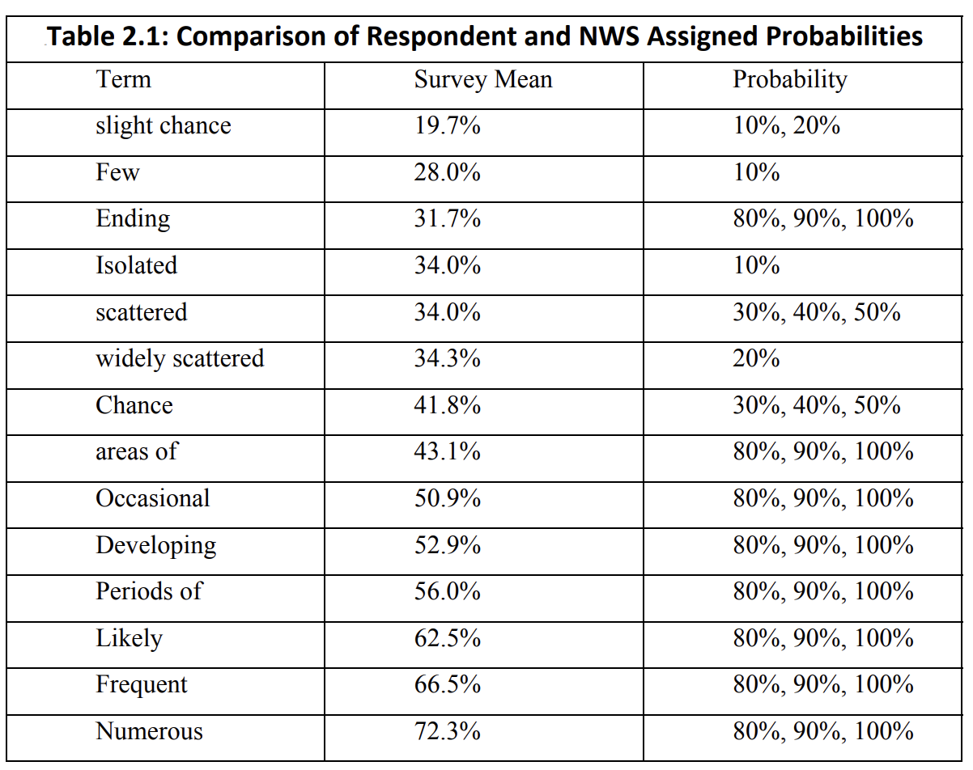
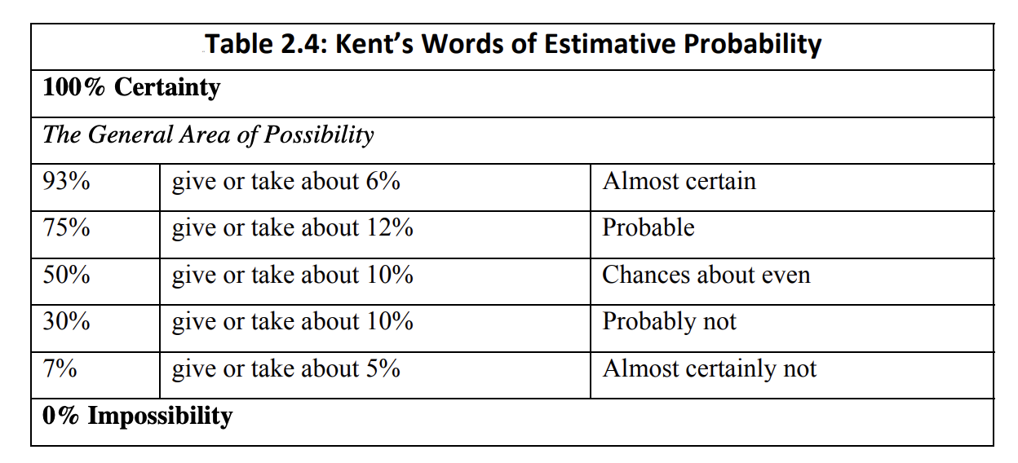
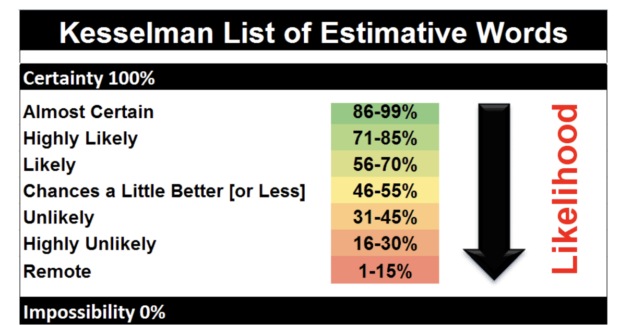
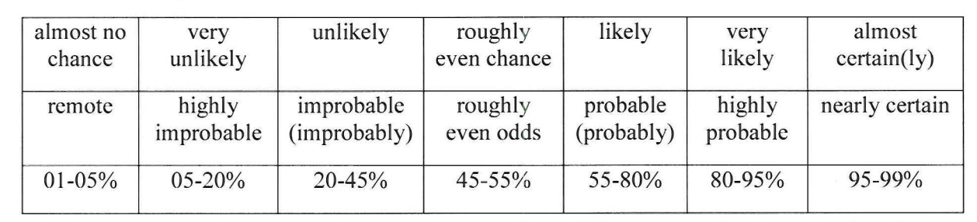
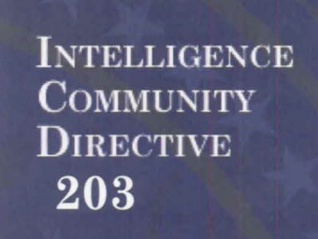
????????

Slide 46
NIE Revisited
Throughout the NIE justifying war with Iraq, intelligence analysts were only able to offer “risky” inductive arguments
An NIE must be signed by the heads of all intelligence agencies, which suggests there is a common understanding of the arguments...
UNLIKELY

Slide 47
Evidence & Valid Arguments
Among the goals of intelligence analysis is to provide justification for conclusions drawn from investigations
Justification is often tied up in argumentation; broadly speaking we can distinguish three major types of argument
Deductive Arguments
Inductive Arguments
Abductive Arguments

Slide 48
Abductive Arguments
Abductive arguments involve conclusions that are considered the best explanation for some premises
While there are often multiple potential explanations for a given event, some are better than others
A black and white cat that answers to “Otis” begs me for treats at t₁. An identical cat that answers to “Otis” begs me for treats at t₂. The best explanation is that it’s the same cat at both times, namely, my cat Otis.

Slide 49
Abductive Arguments
There are multiple signals of troop movement near a contested border.
Each of the following explain 1:
H₁​: Routine military exercises.
H₂​: Preparation for an invasion.
H₃​: Defensive training mission.
There has been increased political tension in the area.
Previous intelligence indicates potential military escalation.
The best explanation given 1, 3, and 4 is H₂.

Slide 50
Abductive Arguments
There are multiple signals of troop movement near a contested border.
Each of the following explain 1:
H₁​: Routine military exercises.
H₂​: Preparation for an invasion.
H₃​: Defensive training mission.
There has been increased political tension in the area.
Previous intelligence indicates potential military escalation.
The best explanation given 1, 3, and 4 is H₂.
AGAIN, THE CONCLUSION IS NOT GUARANTEED TO FOLLOW

Slide 51
Best Explanation(s)
Putative best explanations for conclusions drawn in the NIE justifying war with Iraq were contrasted in that same document with alternative explanations

Slide 52
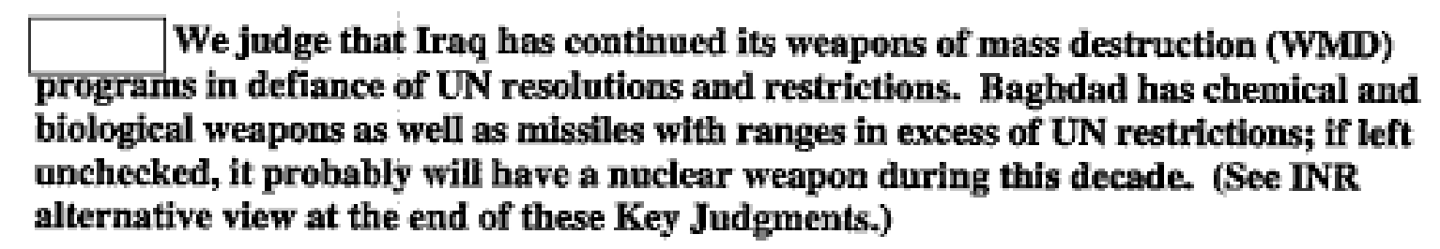
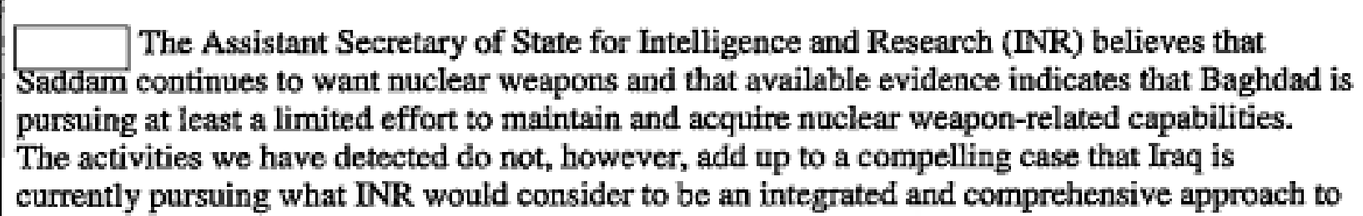
Best Explanation(s)
Putative best explanations for conclusions drawn in the NIE justifying war with Iraq were contrasted in that same document with alternative explanations

Slide 53
Best Explanation(s)
Putative best explanations for conclusions drawn in the NIE justifying war with Iraq were contrasted in that same document with alternative explanations

Slide 54
Summary
We have explored – through the context of the National Intelligence Estimate used to justify the war in Iraq – challenges and uses of intelligence in high stakes circumstances
We leveraged resources from contemporary epistemology to add structure to our investigation
Ultimately closing by outlining forms of “risky” argument often offered by intelligence analysts

Slide 55
Readings
National Security Intelligence Activity: A Philosophical Analysis
Rethinking Intelligence Practices and Processes

